Slide 1
U.Elakkiya
IBM_FE4F609EFF5CAEF8F4E40C518B2B010D

Slide 2


Mission statement: Your company’s mission goes here

Slide 3
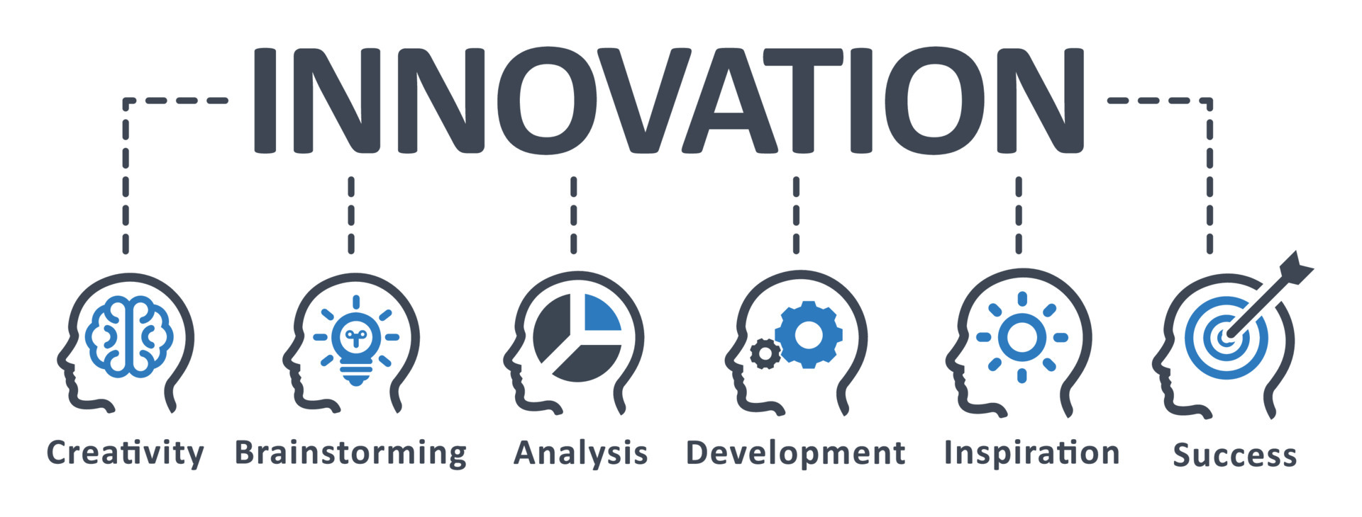
The problem
Frame the problem for the audience.
Quantify the scope of the problem and connect it to your audience.
20XX | 20XX | 20XX | 20XX

Slide 4

Phase 2: innovation
The 5 Stages in the Design Thinking Process

Slide 5
Design thinking is a methodology which provides a solution-based approach to solving problems. It’s extremely useful when used to tackle complex problems that are ill-defined or unknown—because it serves to understand the human needs involved, reframe the problem in human-centric ways, create numerous ideas in brainstorming sessions and adopt a hands-on approach to prototyping and testing. Learning about the five stages of design thinking will empower you and allow you to apply the methodology to your work and solve complex problems that occur in our companies, our countries, and across the world.
Design thinking is a non-linear, iterative process that can have anywhere from three to seven phases, depending on whom you talk to. We focus on the five-stage design thinking model proposed by the Hasso Plattner Institute of Design at Stanford (the d.school) because they are world-renowned for the way they teach

Slide 6
Table of contents
What are the 5 Stages of the Design Thinking Process
Stage 1: Empathize—Research Your Users' Needs
Stage 2: Define—State Your Users' Needs and Problems
Stage 3: Ideate—Challenge Assumptions and Create Ideas
Stage 4: Prototype—Start to Create Solutions
Stage 5: Test—Try Your Solutions Out
Did You Know Design Thinking is a Non-Linear Process?
The Take Away
References & Where to Learn More
Images

Slide 7
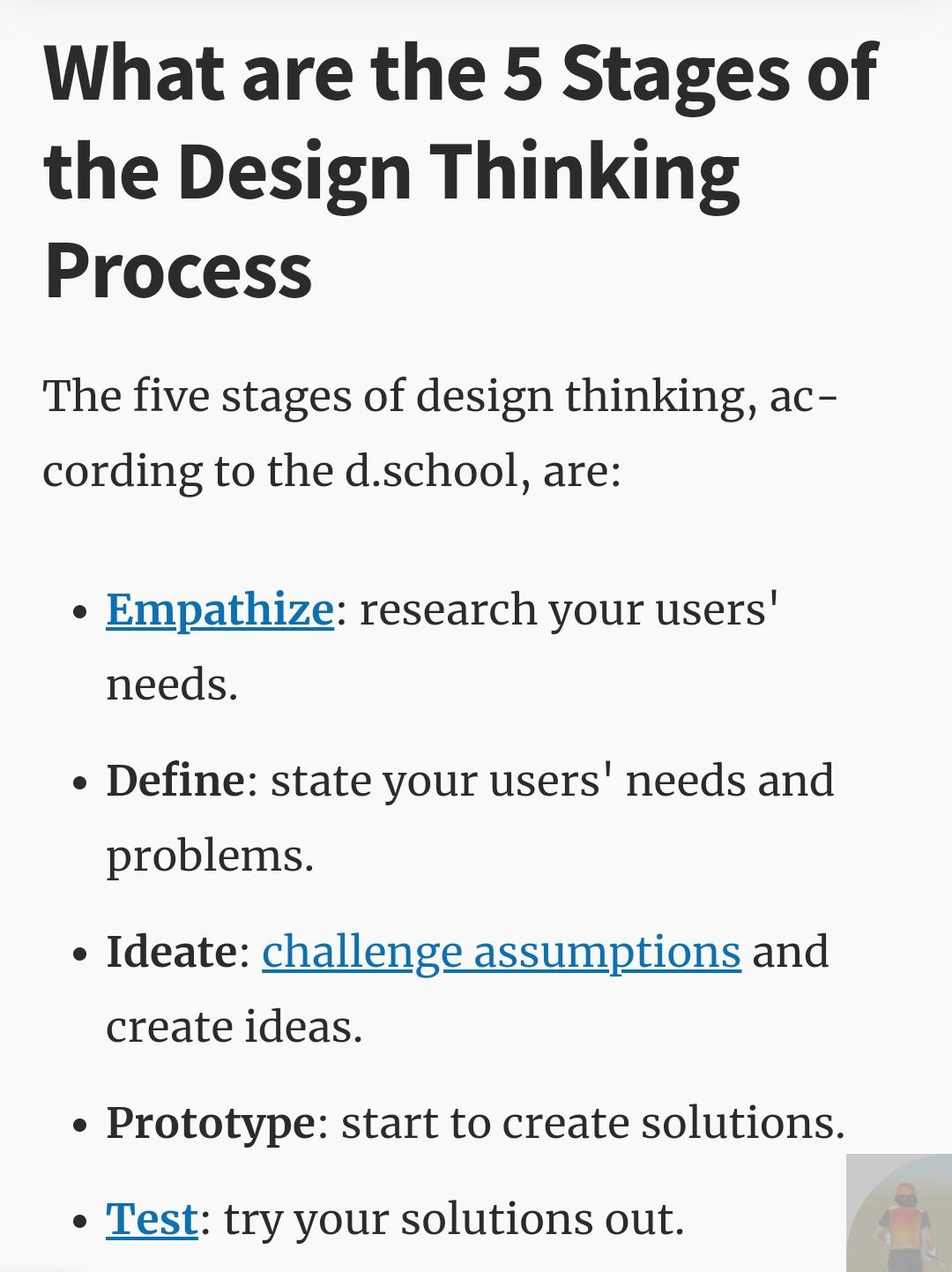

Slide 8
Let’s dive into each stage of the design thinking process.

Slide 9
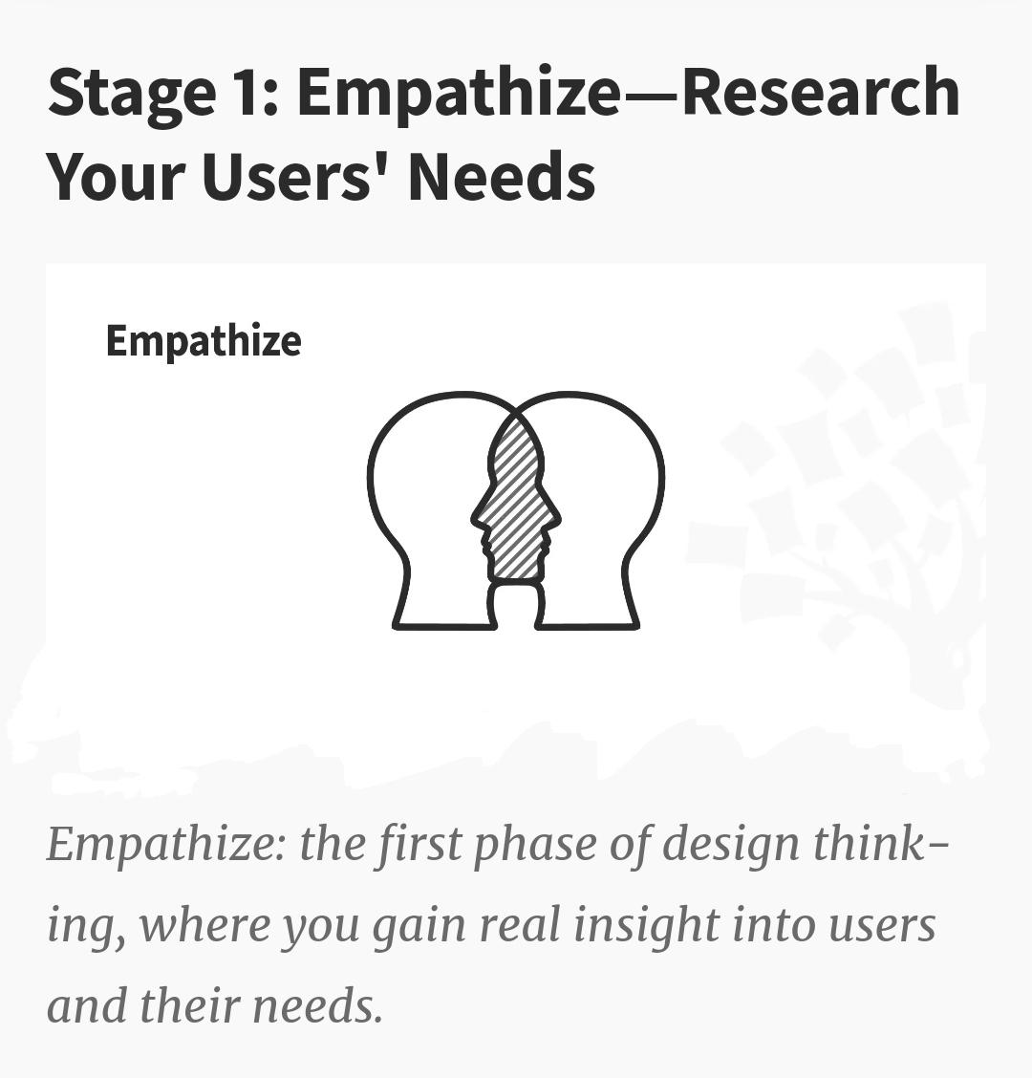

Slide 10
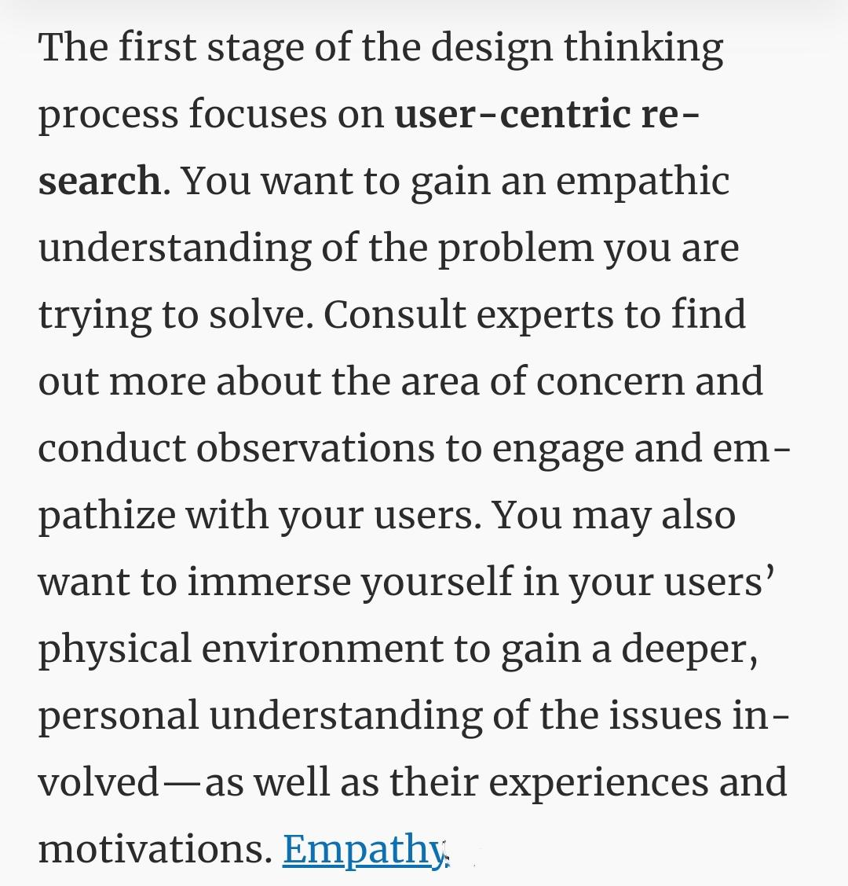

Slide 11
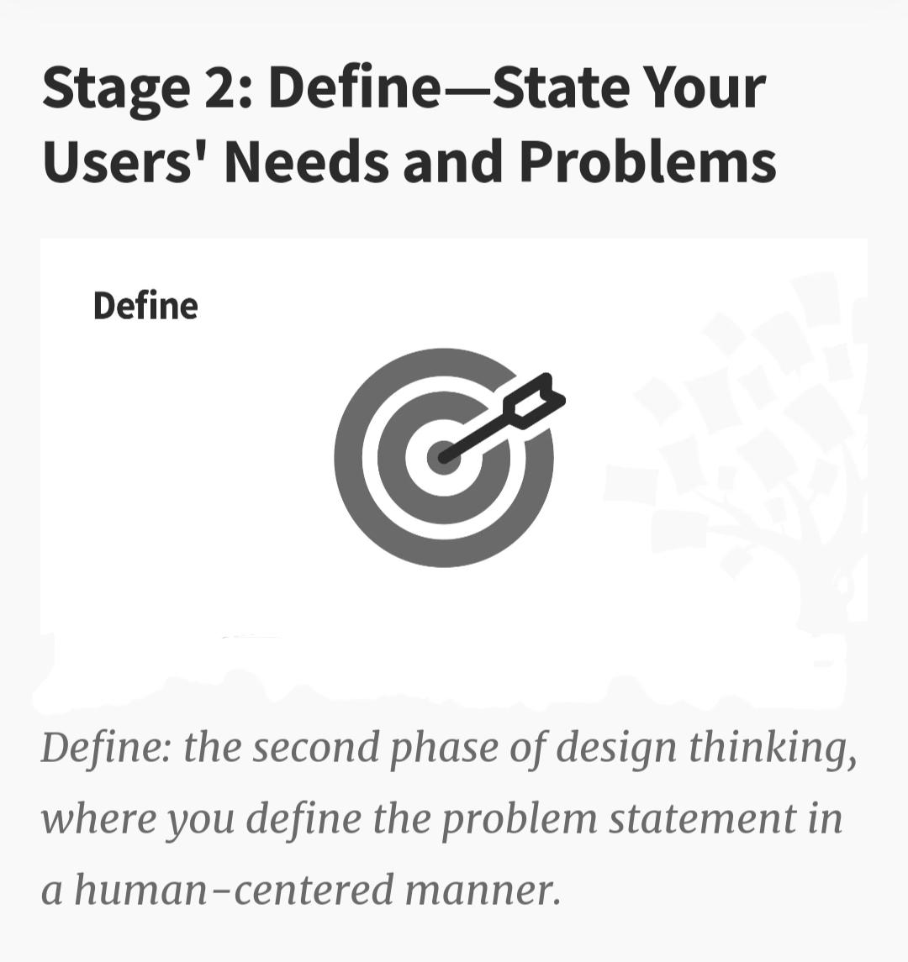

Slide 12
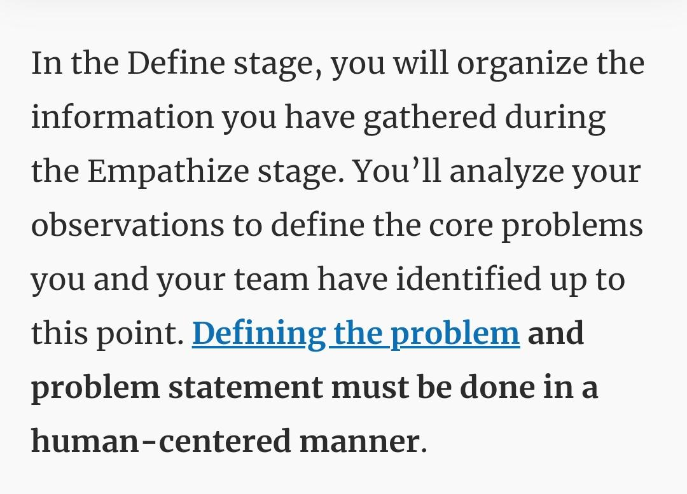

Slide 13
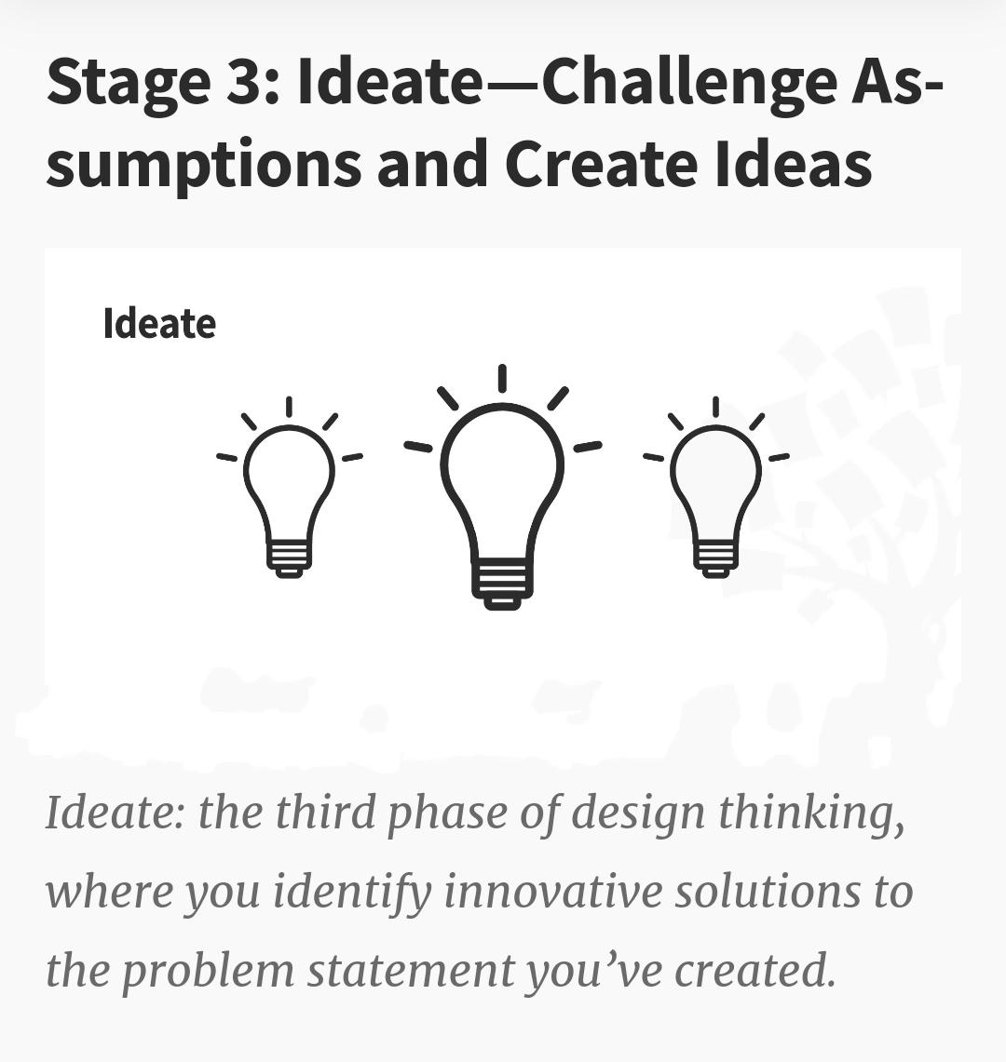

Slide 14
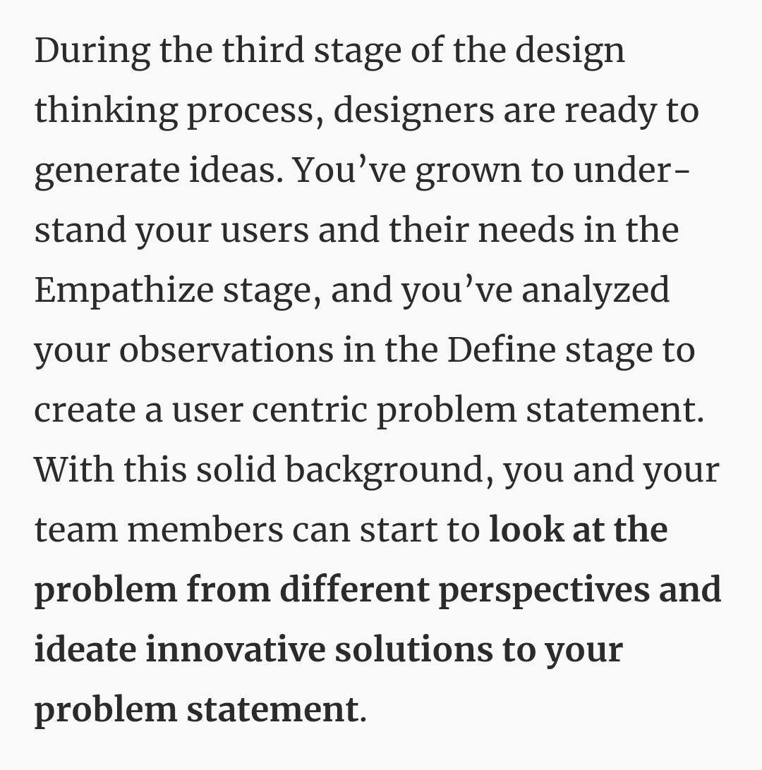

Slide 15
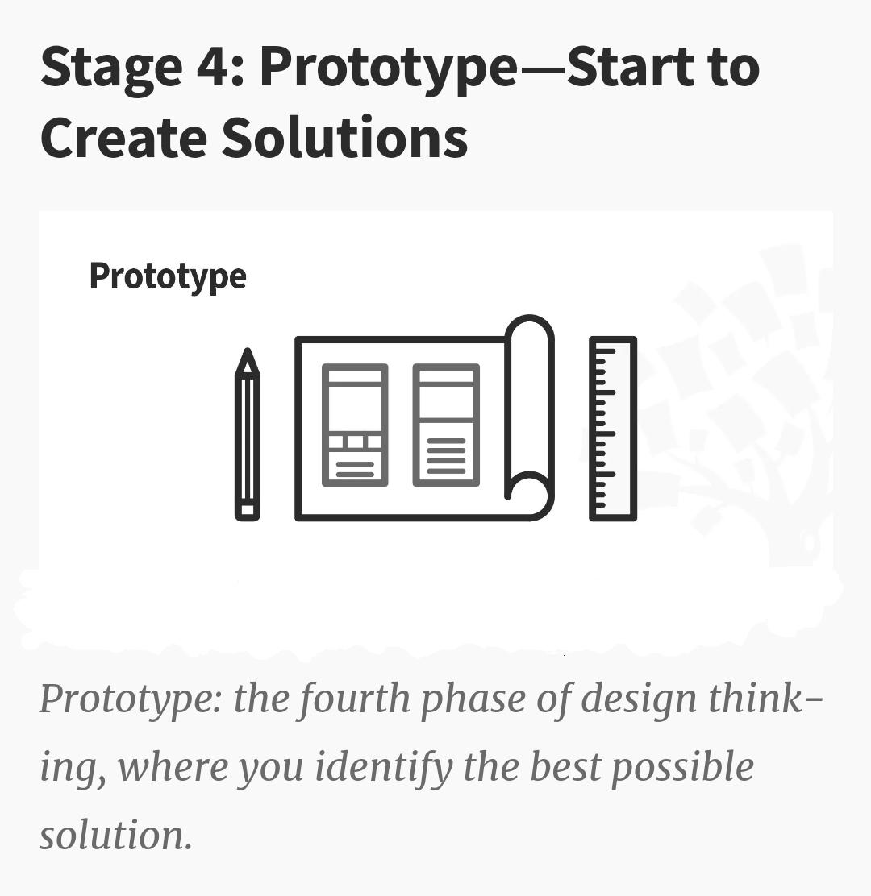

Slide 16
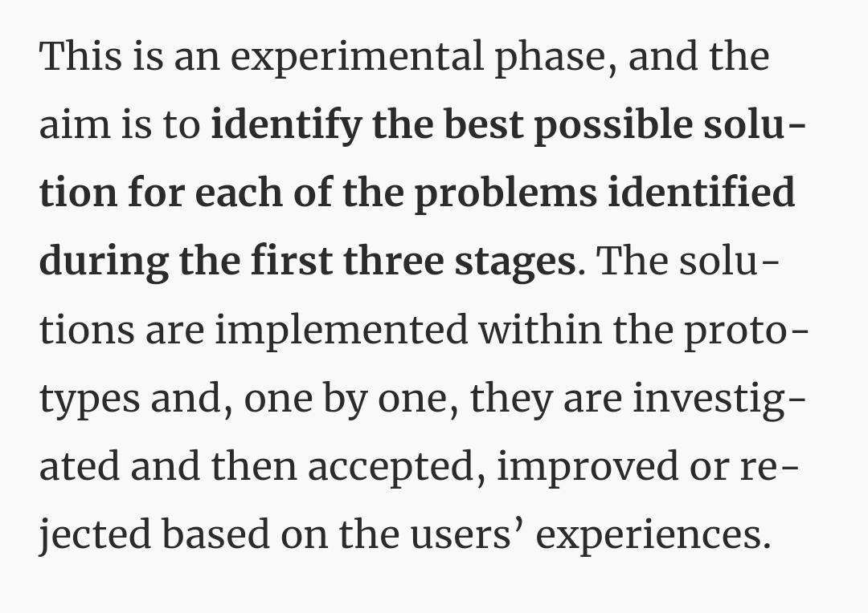

Slide 17
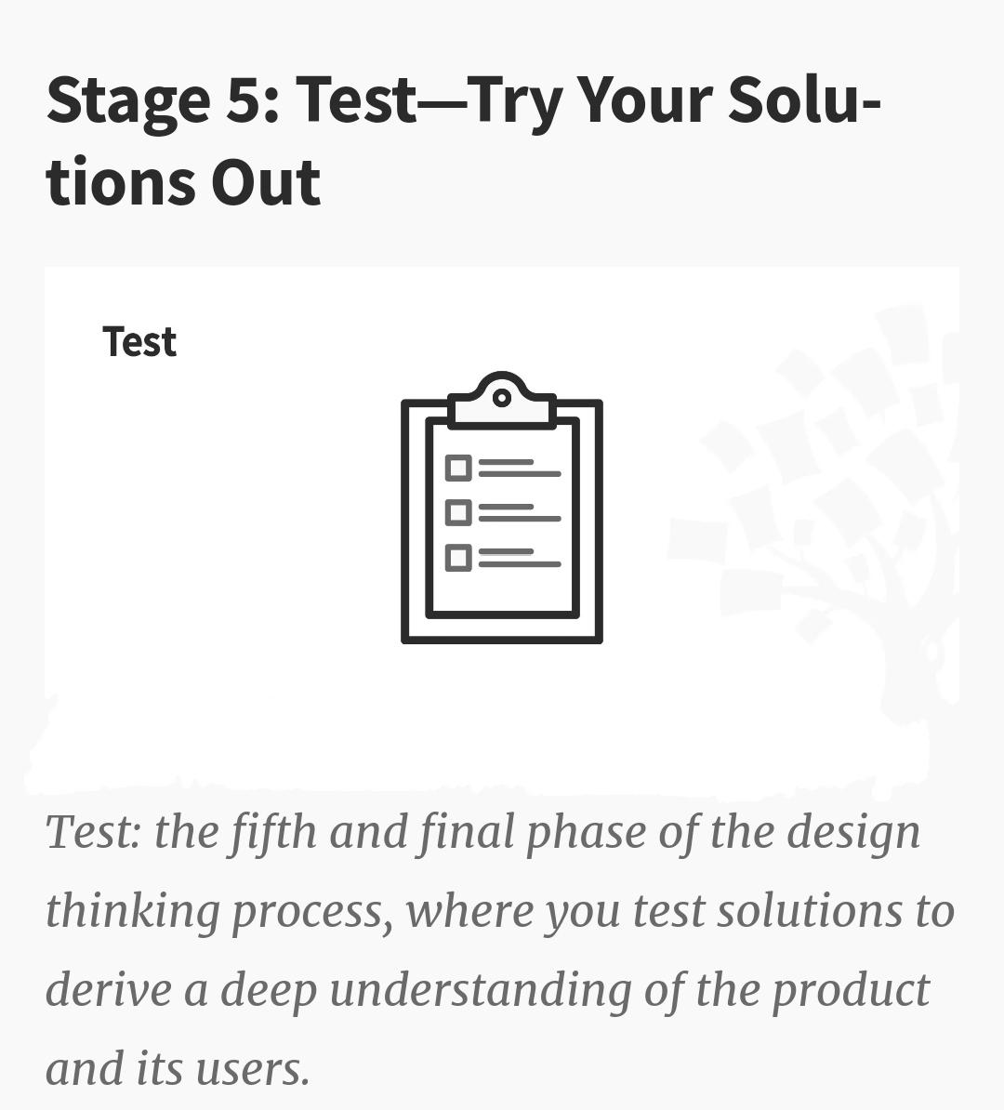

Slide 18
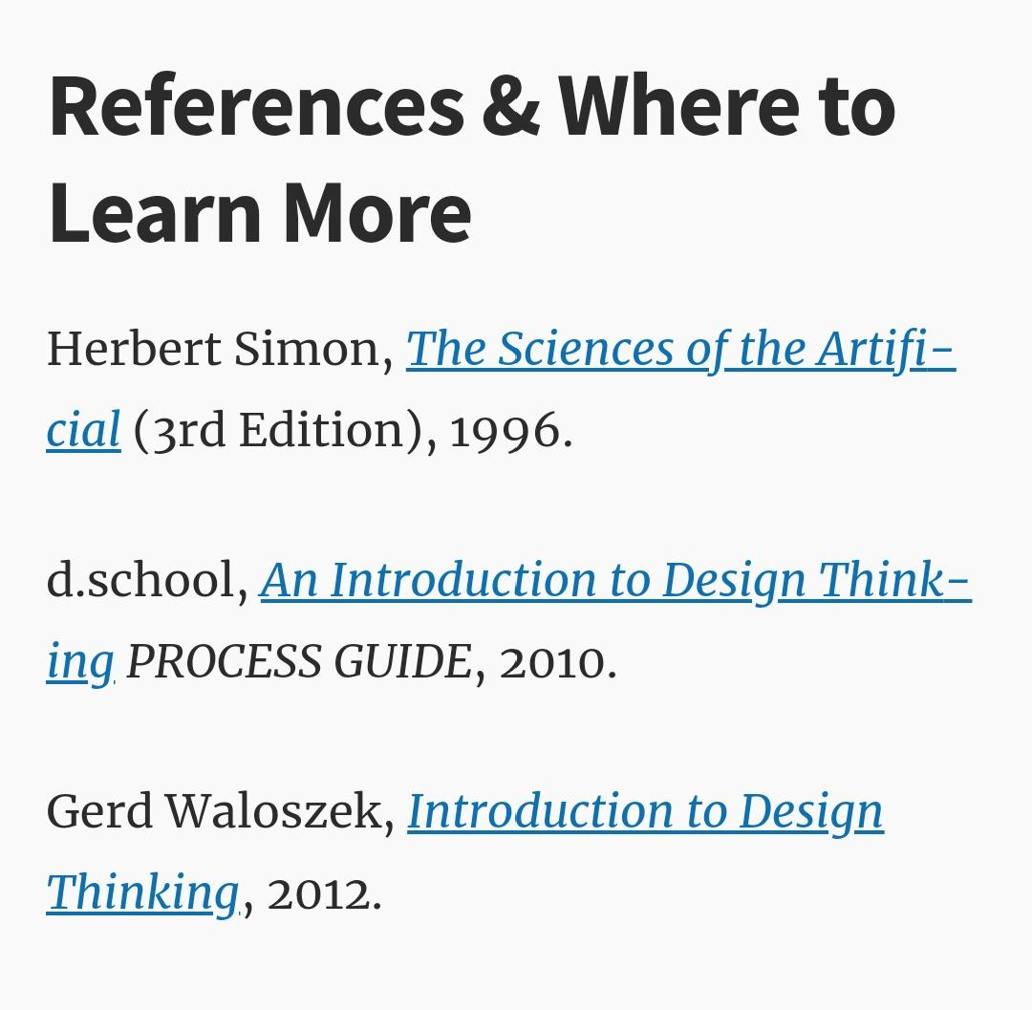

Slide 19
Thank you

